Slide 1
Elasticsearch
Lluís Rubíes Mesa
June 2021

Slide 2
Characteristics

Slide 3
Used in ELK stack (Elastic, LogStash, Kibana)
Is a NOSQL database
Based on Lucene search engine
Used for analytics, machine learning, …

Slide 4
Components

Slide 5
Document: Stored in JSON. Identified with UUID
Index: Collection documents
Node: Elasticsearch Instance
Cluster: Collection one or more nodes.

Slide 6
ELK Stack

Slide 7
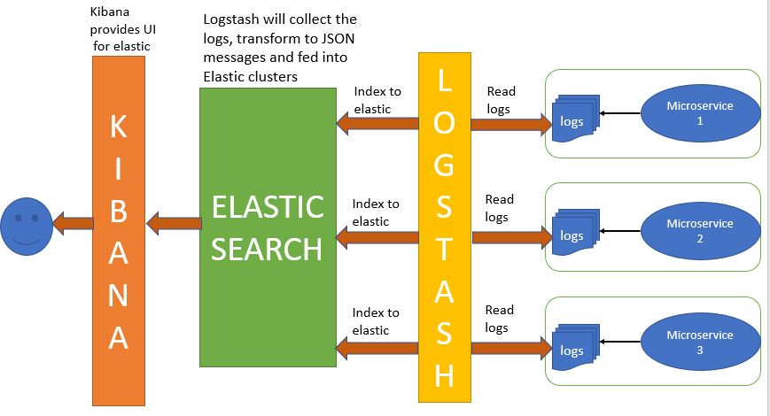

Slide 8
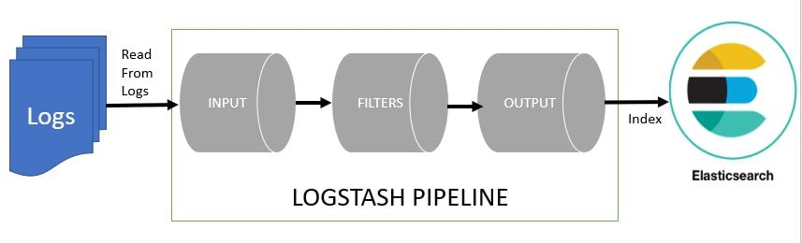
Filters use Grok

Slide 9
Demo

